Slide 1
Planning and Cabling Networks
Network Fundamentals – Chapter 10

Slide 2
Objectives
Identify the basic network media required to make a LAN connection.
Identify the types of connections for intermediate and end device connections in a LAN.
  Identify the pin out configurations for straight-through and crossover cables.
  Identify the different cabling types, standards and ports used for WAN connections.
  Define the role of device management connections when using Cisco equipment.
Design an addressing scheme for an inter-network and assign ranges for hosts, network devices and the router interface.
Compare and contrast the importance of network designs.

Slide 3
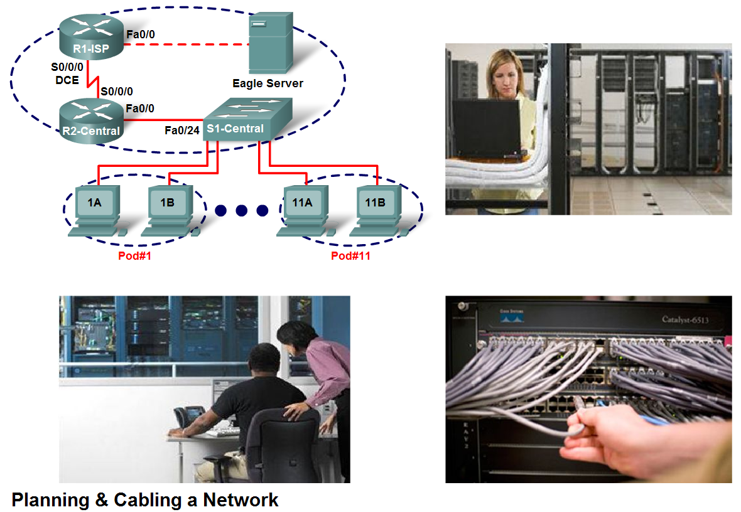
Basic Network Media Required to Make a LAN Connection
Select the appropriate hardware, including the cabling, to install several computers together in a LAN

Slide 4

Basic Network Media Required to Make a LAN Connection
To identify some key aspects of the devices they will be employing in a LAN

Slide 5
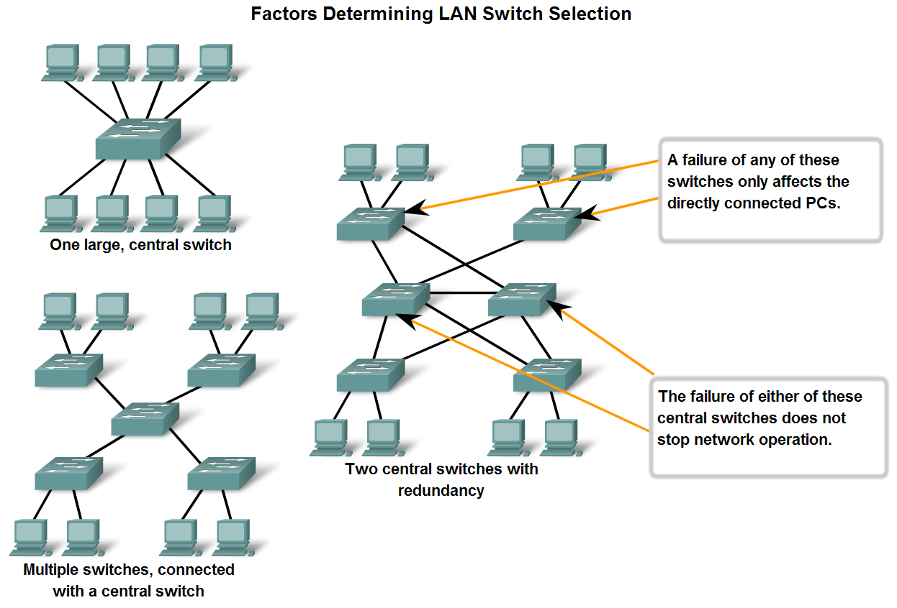
Basic Network Media Required to Make a LAN Connection
Connect two computers with a switch

Slide 6
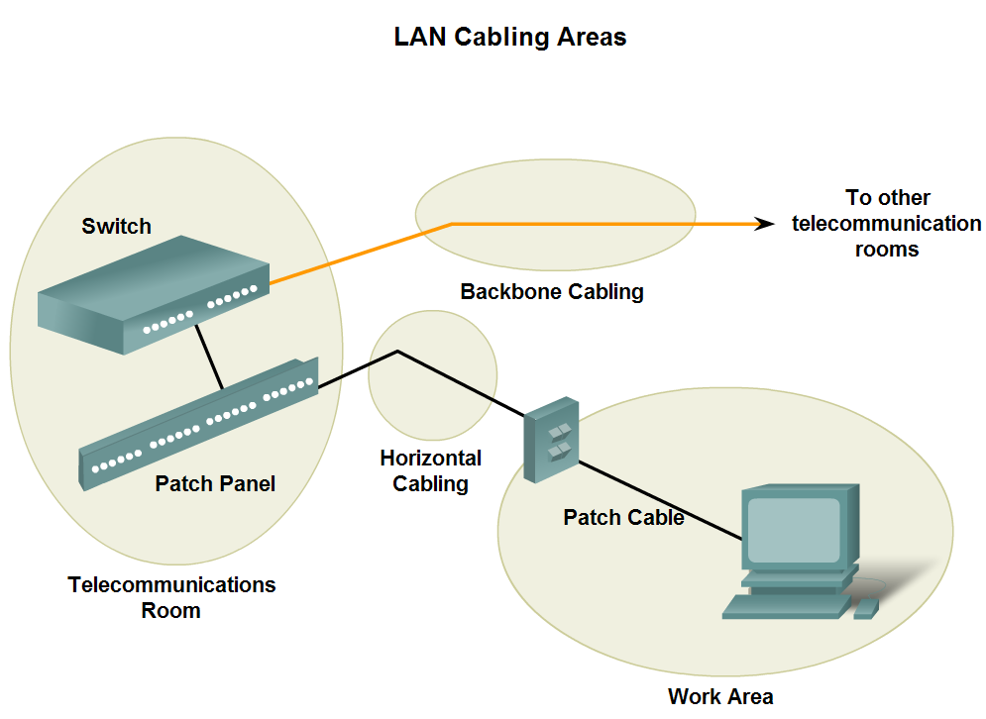
Types of Connections in a LAN
Given a specific network connection, identify the type of cable required to make the connection

Slide 7
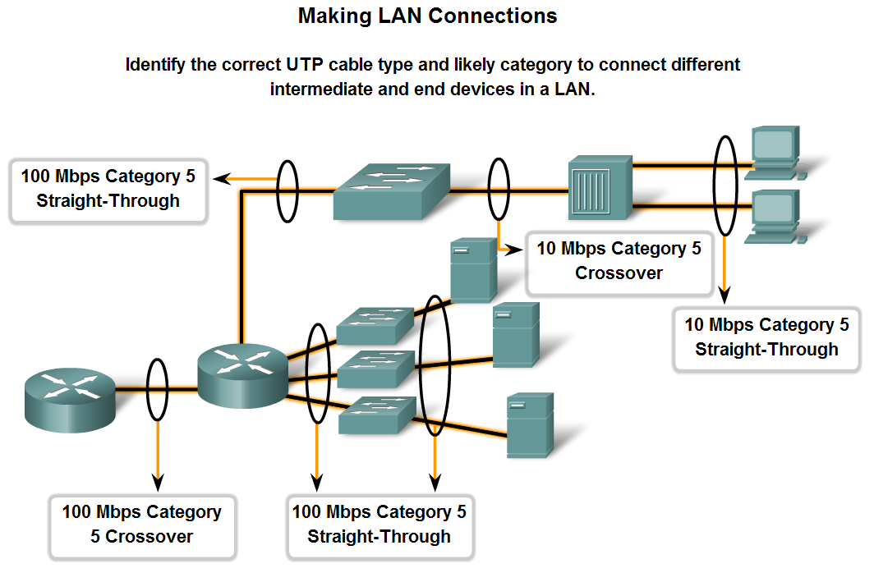
Types of Connections in a LAN
Identify the correct cable to use in connecting intermediate and end devices in a LAN

Slide 8
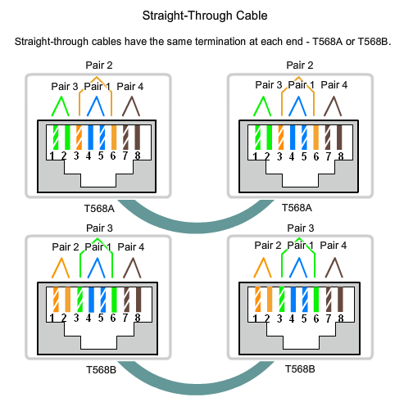
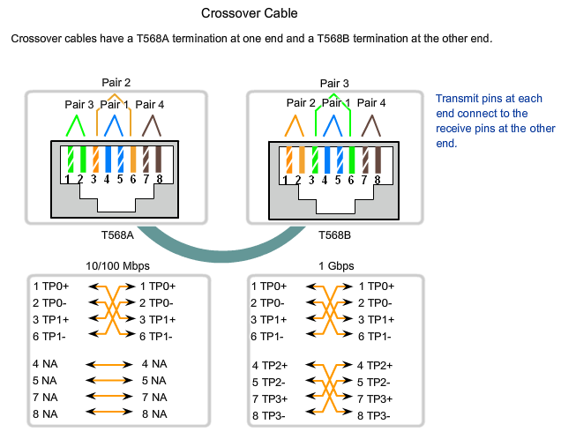
Types of Connections in a LAN
Identify the pinout of the straight-through and cross-over cables

Slide 9
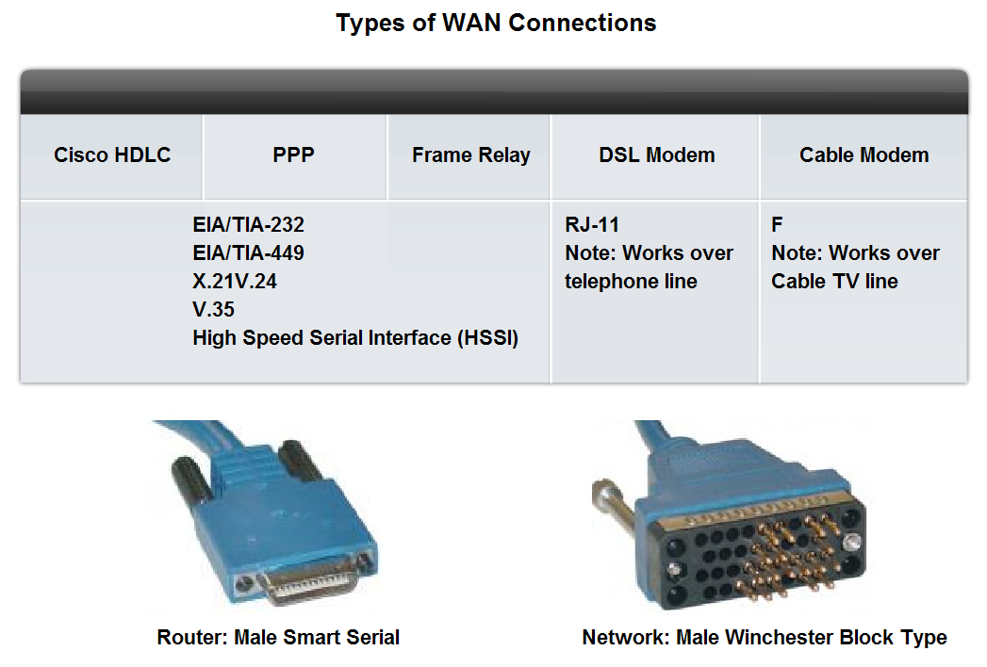
Types of Connections in a LAN
Recognize that a different class of cables is used to connect WANs, and that the cables, standards and ports are different than those in use by LANs

Slide 10
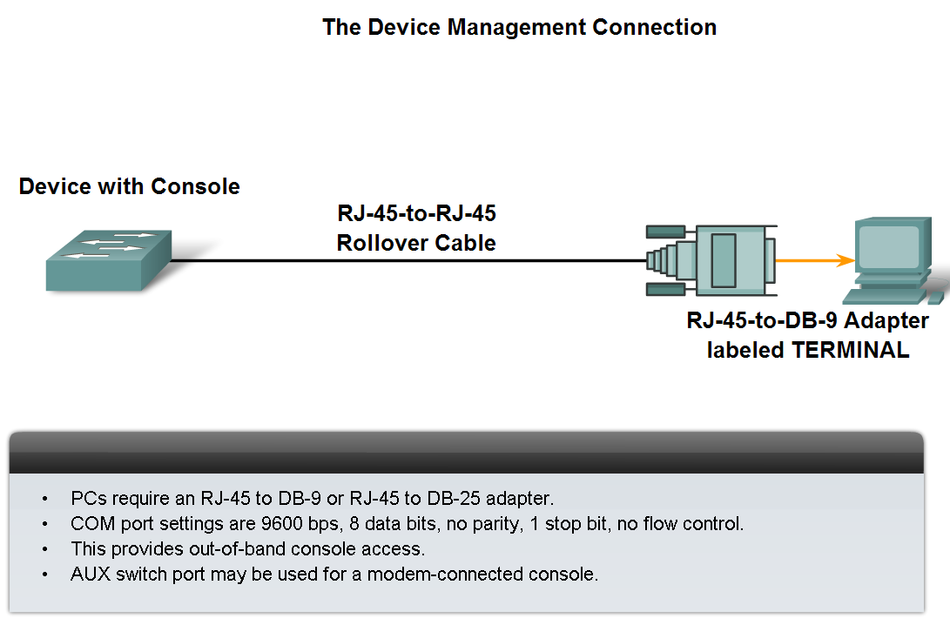
Types of Connections in a LAN
Define the role of device management connections when using Cisco equipment

Slide 11
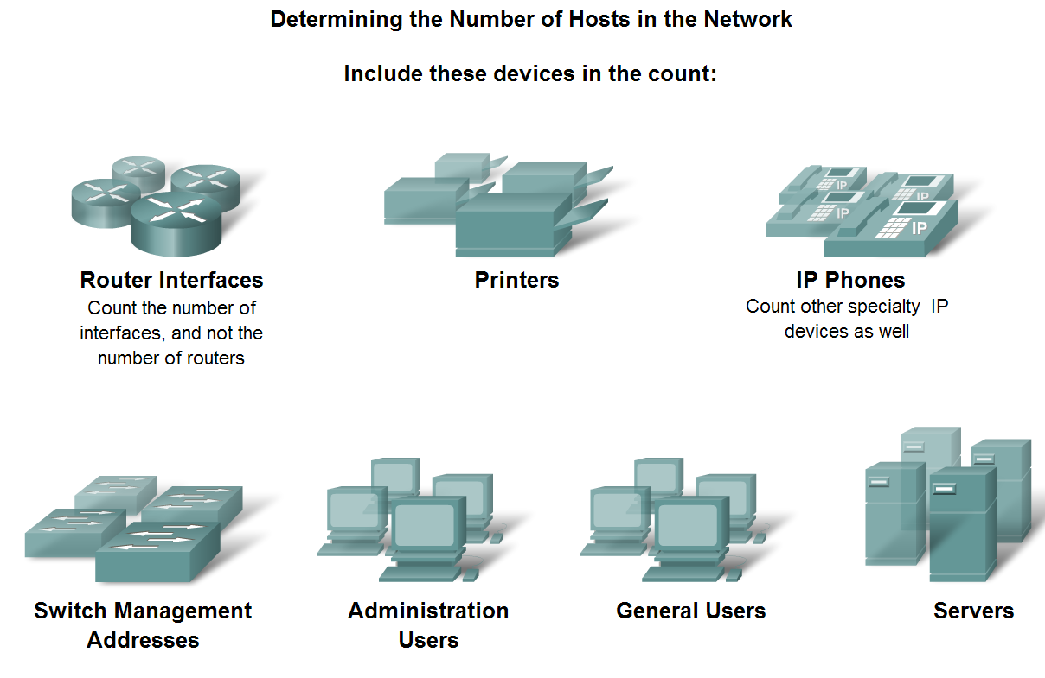
Design an Addressing Scheme for an Internetwork
Design an address scheme for an internetwork and assign ranges for hosts, network devices and the router interface

Slide 12
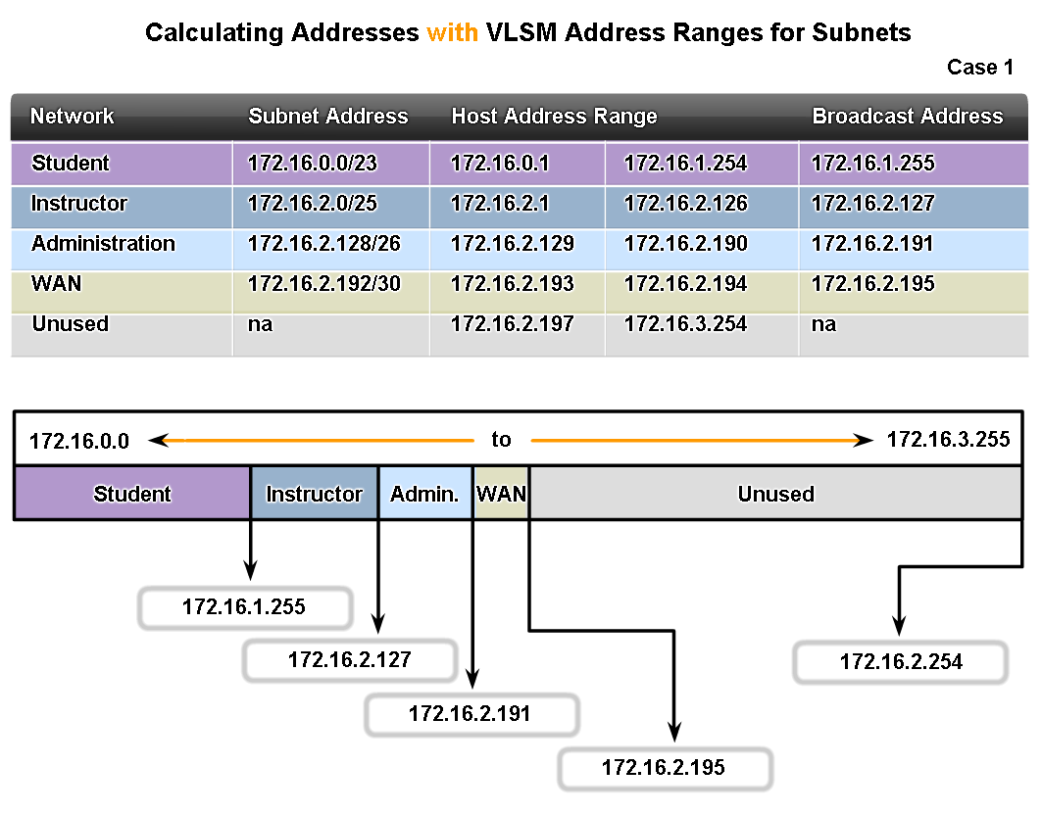
Design an Addressing Scheme for an Internetwork
Calculate the address ranges for sub networks

Slide 13

Importance of Network Designs
Given a network scenario, develop an appropriate networking scheme

Slide 14
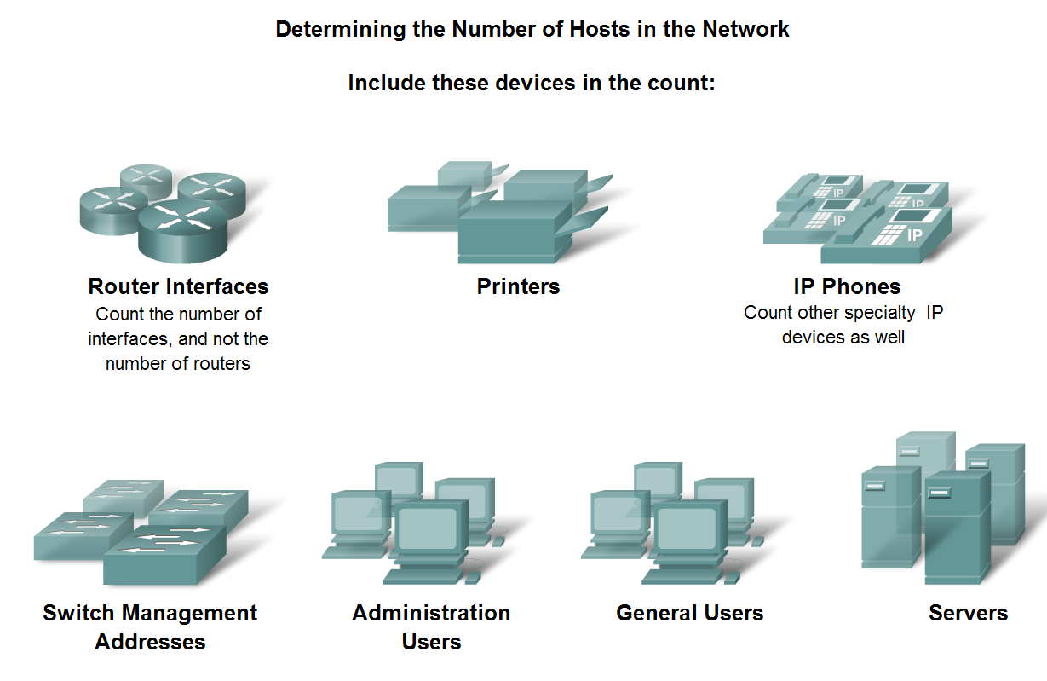
Importance of Network Designs
Determine the total number of hosts in a network, accounting for present and future requirements

Slide 15
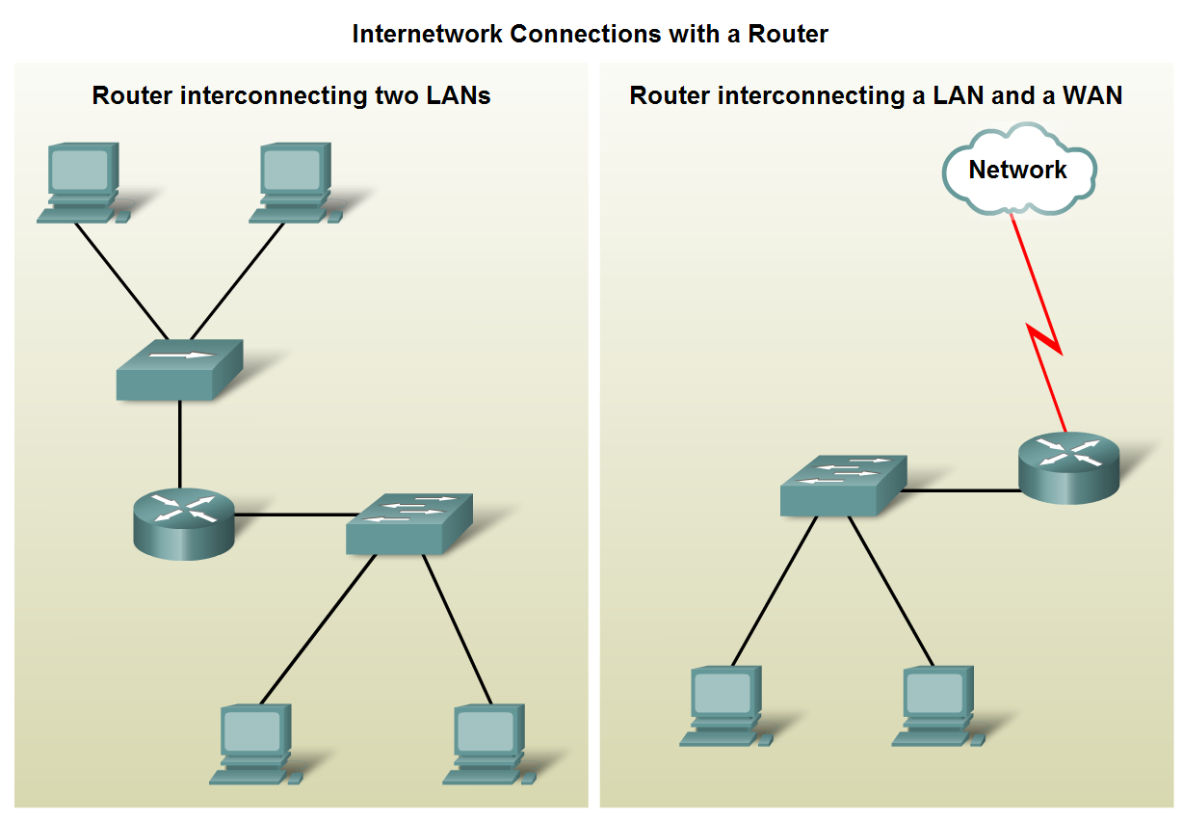
Importance of Network Designs
Given a network requirement, determine the optimum number of sub networks in the larger internetwork

Slide 16
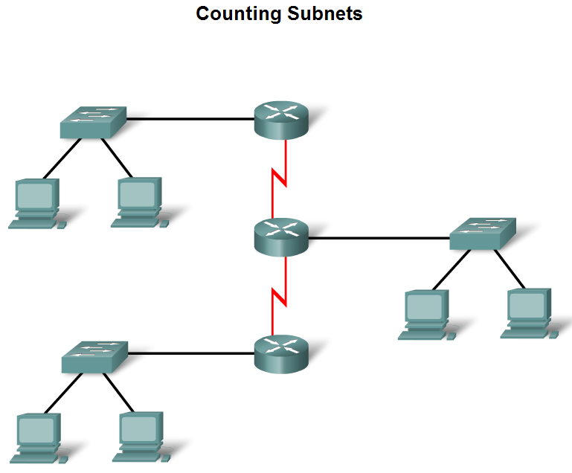
Importance of Network Designs
Describe how to count the segments between router interfaces

Slide 17
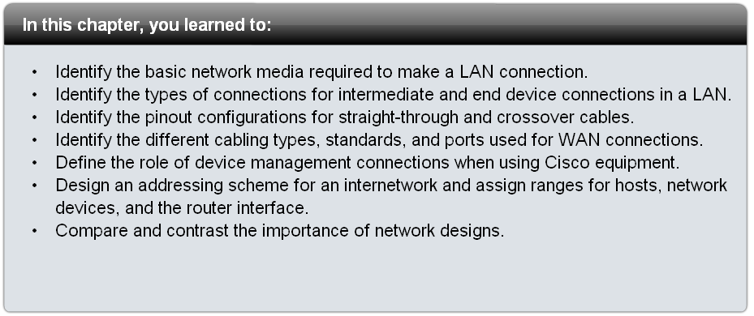
Summary

